Slide 1

Multimedia Data Management
Lecture 9 – Ajax / XML
Fall 2022

Slide 2
How can we exchange data more efficiently?

Slide 3
XML Introduction
XML: Extensible Markup Language
Markup: anything in a document that is not intended to be part of the printed output.
Documents have tags giving extra information about sections of the document.
Extensible: unlike HTML, users can add new tags, and separately specify how the tag should be handled for display

Slide 4
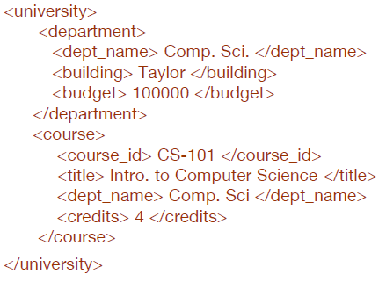
XML Introduction
The ability to specify new tags, and to create nested tag structures make XML a great way to exchange data, not just documents.
Much of the use of XML has been in data exchange applications, not as a replacement for HTML
Tags make data (relatively) self-documenting

Slide 5
XML Use Case
Purchase orders are typically generated by one organization and sent to another.
This slow process can be greatly sped up by sending the information electronically between the purchaser and supplier.
XML provides a standard way of tagging the data.
The two organizations must of course agree on what tags appear in the purchase order, and what they mean.

Slide 6
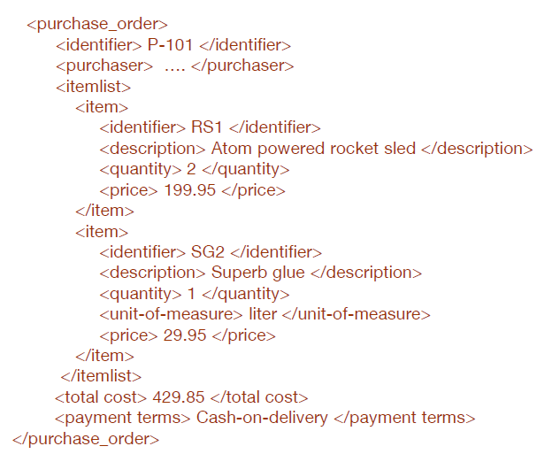
XML Example

Slide 7
XML vs Relational Data
Inefficient: tags, which in effect represent schema information, are repeated
Better than relational tuples as a data-exchange format
Unlike relational tuples, XML data is self-documenting due to presence of tags
Non-rigid format: tags can be added or ignored
Allows nested structures
Wide acceptance, not only in database systems, but also in browsers, tools, and applications

Slide 8
Structure of XML Data
Tag: label for a section of data
Element: section of data beginning with <tagname> and ending with matching </tagname>
Every document must have a single top-level root element
That encompasses all other elements in the document
E.g., <university> ... </university>
Elements must be properly nested
Proper nesting: <course> … <title> …. </title> </course>
Formally: every start tag must have a unique matching end tag, that is in the context of the same parent element.

Slide 9
Motivation for Nesting
Each purchase order has a purchaser and a list of items as two of its nested structures.
Each item in turn has an item identifier, description and a price nested within it.
The purchaser has a name and address nested within it.
Such information are normally split into multiple relations in a relational schema:
Item information
Purchaser information
Purchase orders
The relationship between purchase orders, purchasers, and items

Slide 10
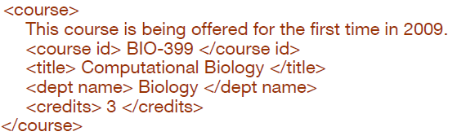
Structure of XML Data
Mixture of text with sub-elements is legal in XML.
Example:
Useful for document processing rather than data processing which deals with structured data

Slide 11
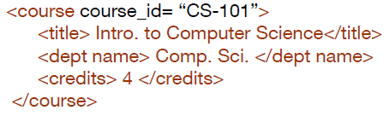
Structure of XML Data
Elements can have attributes
Attributes are specified by name=value pairs inside the starting tag of an element
An element may have several attributes, but each attribute name can only occur once

Slide 12
Attributes vs. Subelements
Distinction between subelement and attribute
In the context of documents, attributes are part of markup, while subelement contents are part of the basic document contents
In the context of data representation, the difference is unclear and may be confusing
Suggestion: use attributes for identifiers of elements, and use subelements for other contents

Slide 13
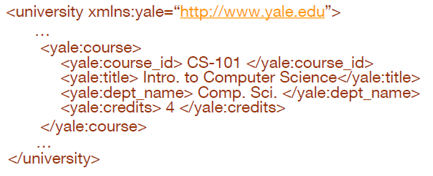
Namespaces
XML data must be exchanged between organizations
Same tag name may have different meaning in different organizations, causing confusion on exchanged documents
Specifying a unique string as an element name avoids confusion
Better solution: use unique-name:element-name
Avoid using long unique names all over document by using XML Namespaces

Slide 14
XML Syntax Cont.
Elements without subelements or text content can be abbreviated by single tags:
To store string data that may contain tags, without the tags being interpreted as subelements, use CDATA as below
Here, <course> and </course> are treated as just strings
CDATA stands for “character data”

Slide 15
XML Document Schema
Database schemas constrain what information can be stored, and the data types of stored values
XML documents are not required to have an associated schema
However, schemas are very important for XML data exchange
Otherwise, a site cannot automatically interpret data received from another site
Two mechanisms for specifying XML schema
Document Type Definition (DTD)
XML Schema
Notes:
XML Schema is newer

Slide 16
Document Type Definition (DTD)
The type of an XML document can be specified using a DTD
DTD constraints structure of XML data
What elements can occur
What attributes can/must an element have
What subelements can/must occur inside each element, and how many times.
DTD does not constrain data types like integer ...
All values represented as strings in XML
DTD syntax
<!ELEMENT element (subelements-specification) >
<!ATTLIST element (attributes) >

Slide 17
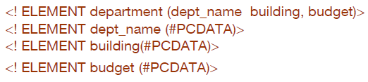
Element Specification in DTD
Subelements can be specified as
names of elements, or
#PCDATA (parsed character data), i.e., character strings
EMPTY (no subelements) or ANY (anything can be a subelement)
Example

Slide 18
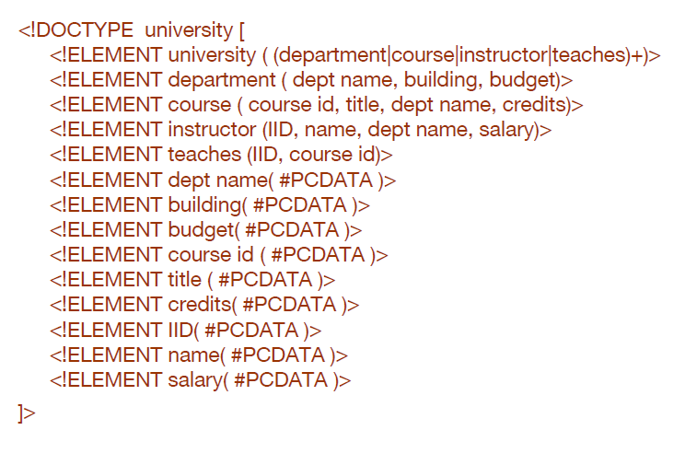
University DTD

Slide 19
Element Specification in DTD
Subelement specification may have regular expressions
Notation:
“|” – or
“+” - 1 or more occurrences
“*” - 0 or more occurrences
“?” - 0 or 1 occurrence

Slide 20
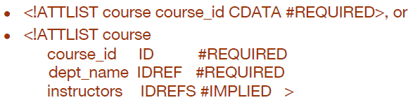
Attribute Specification in DTD
Attribute specification : for each attribute
Name
Type of attribute
CDATA
ID (identifier) or IDREF (ID reference) or IDREFS (multiple IDREFs)
Whether
mandatory (#REQUIRED)
or not (#IMPLIED)
Examples

Slide 21
IDs and IDREFs
An element can have at most one attribute of type ID
The ID attribute value of each element in an XML document must be distinct
Thus, the ID attribute value is an object identifier
An attribute of type IDREF must contain the ID value of another element in the same document
An attribute of type IDREFS contains a set of (0 or more) ID values. Each ID value must contain the ID value of an element in the same document

Slide 22
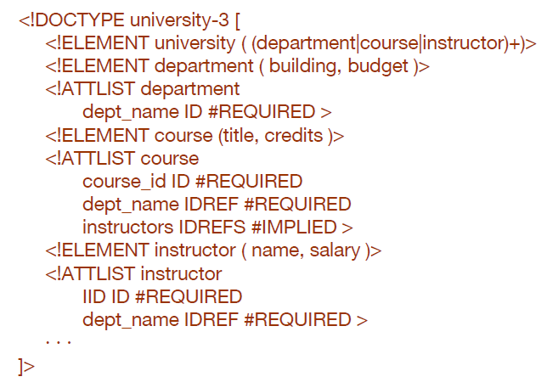
University DTD with Attributes

Slide 23
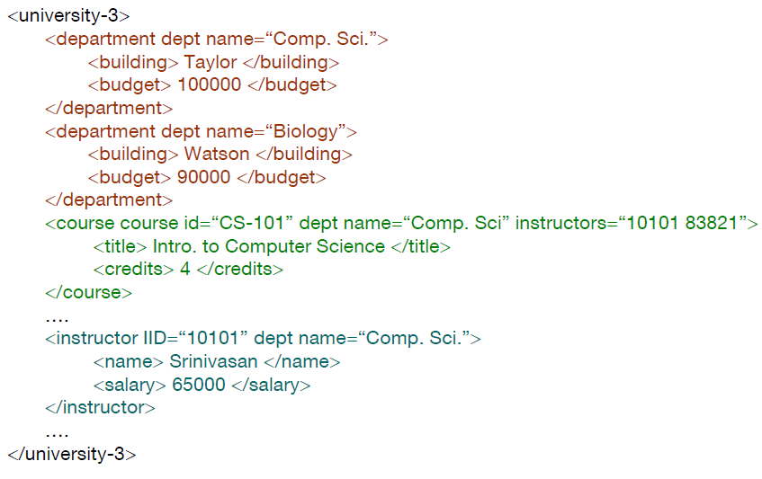
XML data with ID and IDREF attributes

Slide 24
Limitations of DTDs
No typing of text elements and attributes
All values are strings, no integers, floats, etc.
Difficult to specify unordered sets of subelements
(A | B)* allows specification of an unordered set
Cannot ensure the number of times each of A and B occurs
IDs and IDREFs are untyped
The instructors attribute of a course may contain a reference to a department or another course, which is meaningless
instructors attribute should ideally be constrained to refer to instructor elements

Slide 25
XML Schema
XML Schema is a more sophisticated schema language which addresses the drawbacks of DTDs.
Supports typing
Built-in types
E.g., string, integer, decimal, and boolean
Also, constraints on min/max values
User-defined types
Simple types with added restrictions
Complex types constructed using constructors
Many more features, including
uniqueness and foreign key constraints, inheritance

Slide 26
XML Schema
XML Schema is itself specified in XML syntax, unlike DTDs
More-standard representation, but verbose
XML Scheme is integrated with namespaces; E.g., “xs:”
BUT: XML Schema is significantly more complicated than DTDs.

Slide 27
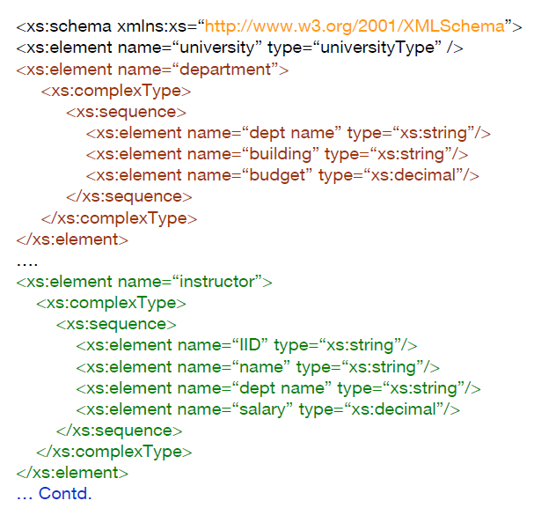
XML Schema of University

Slide 28
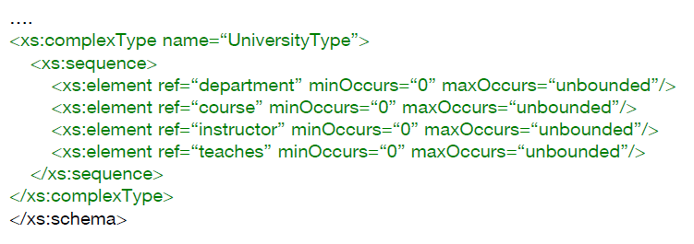
XML Schema of University
Choice of “xs:” was ours -- any other namespace prefix could be chosen
Element “university” has type “universityType”, which is defined separately
xs:complexType is used later to create the named complex type “UniversityType”

Slide 29
More features of XML Schema
Attributes specified by xs:attribute tag:
adding the attribute use = “required” means value must be specified

Slide 30
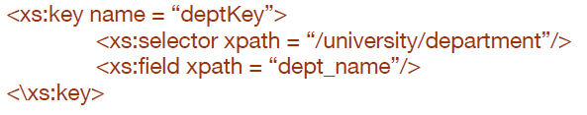
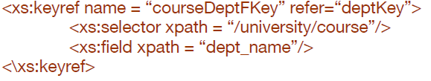
More features of XML Schema
Key constraint: “department names form a key for department elements under the root university element:
Foreign key constraint from course to department:

Slide 31
XML Schema vs DTD
Constraining elements texts to specific types; e.g., numeric types or complex types
User-defined types
Uniqueness and foreign-key constraints.
Integrating with namespaces to allow different parts of a document to conform to different schemas.
Restricting types to create specialized types, for instance by specifying minimum and maximum values.
Complex types to be extended by using a form of inheritance.

Slide 32
Querying XML Data
XPath
Simple language consisting of path expressions
a building block for XQuery
XQuery
an XML query language with a rich set of features
it is modeled after SQL but is significantly different, since it has to deal with nested XML data.
XQuery also incorporates XPath expressions.
XSLT
Simple language designed for translation from XML to XML and XML to HTML
4It is used primarily in document-formatting applications, rather in data management applications
Notes:
Standard XML querying/translation languages

Slide 33
Tree Model of XML Data
Query and transformation languages are based on a tree model of XML data
An XML document is modeled as a tree, with nodes corresponding to elements and attributes
Element nodes have child nodes, which can be attributes or subelements
Text in an element is modeled as a text node child of the element
Children of a node are ordered according to their order in the XML document
Element and attribute nodes (except for the root node) have a single parent, which is an element node
The root node has a single child, which is the root element of the document

Slide 34
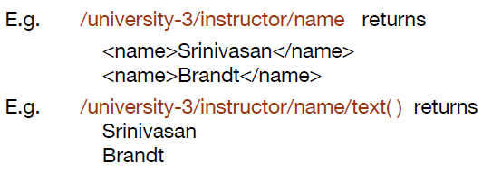
XPath
XPath is used to address (select) parts of documents using path expressions
A path expression is a sequence of steps separated by “/”
Think of file names in a directory hierarchy
Result of path expression: set of values that along with their containing elements/attributes match the specified path
The nodes returned by each step appear in the same order as their appearance in the document.

Slide 35

XPath
The initial “/” denotes root of the document (above the top-level tag)
Path expressions are evaluated left to right
Each step operates on the set of instances produced by the previous step
Attribute values are accessed, using the “@” symbol.
IDREF attributes are not dereferenced automatically

Slide 36
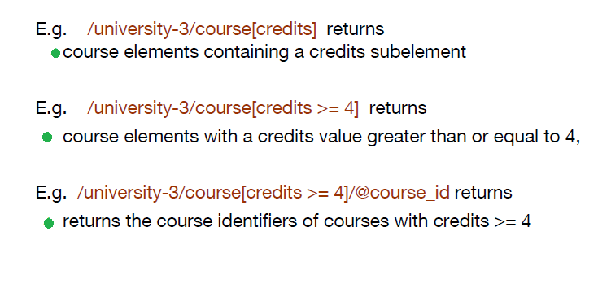
XPath
Selection predicates may follow any step in a path, in [ ]

Slide 37
Functions in XPath
XPath provides several functions
The function count() at the end of a path counts the number of elements in the set generated by the path
E.g. /university-2/instructor[count(./teaches/course)> 2] returns
instructors teaching more than 2 courses (on university-2 schema)
Also function for testing position (1, 2, ..) of node w.r.t. siblings
Boolean connectives and, or and function not() can be used in predicates

Slide 38
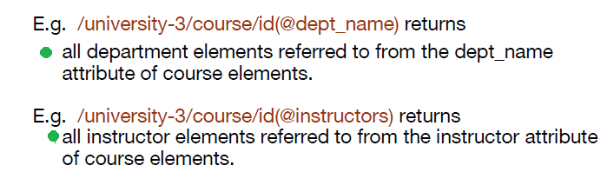
Functions in XPath
The function id(“k”) returns the node (if any) with an attribute of type ID and value “k”.
IDREFs can be referenced using function id()
id() can also be applied to sets of references such as IDREFS and even to strings containing multiple references separated by blanks

Slide 39
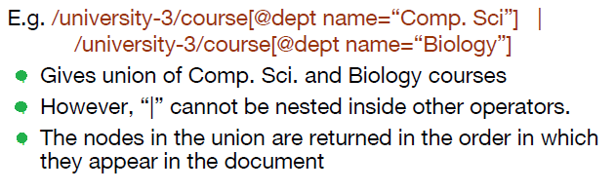
More XPath Features
Operator “|” used to implement union

Slide 40
More XPath Features
doc(name) returns the root of a named document
Thus, a path expression can be applied on a specified document, instead of being applied on the current default document.
E.g. doc(“university.xml”)/university/department returns
all departments at the university
The function collection(name) is similar to doc, but returns a collection of documents identified by name

Slide 41
More XPath Features
“//” can be used to skip multiple levels of nodes
E.g. /university-3//name
finds any name element anywhere under the /university-3 element, regardless of the element in which it is contained.
A step in the path can go to parents, siblings, ancestors and descendants of the nodes generated by the previous step, not just to the children
“//”, described above, is a short form for specifying “all descendants”
“..” specifies the parent.

Slide 42
How can we enhance the way that we use the server to process our requests?

Slide 43
Async Loading Motivation
Consider a sing-up page with password and re-type password fields.
Do we need to send a request to the server to check if they match?
That is the motivation to take asynchronous web page loading.
We use web browsers to do some processing without using the server resources

Slide 44

JavaScript
JavaScript often abbreviated as JS, can be considered as the programming language of the World Wide Web.
As of 2022, 98% of websites use JavaScript on the client side for webpage behavior, often incorporating third-party libraries. All major web browsers have a dedicated JavaScript engine to execute the code on users' devices.
Notes:
So, you can execute JS on your device without the need to a server.
It can lift the load from the servers and move the processing to the browsers (clients). You can serve more clients and your web application will be faster and more efficient.
JS has many frameworks and libraries like Angular, Node, React, Vue, etc. but it is beyond the scope of this course.

Slide 45
AJAX
AJAX (Asynchronous JavaScript And XML) is a technique for accessing web servers from a web page. Together with JS, they can speed up our web applications and enhance user experience, too.
There are some of the capabilities of AJAX:
Read data from a web server - after the page has loaded
Update a web page without reloading the page
Send data to a web server - in the background
Notes:
We should keep using AJAX in a balance. There are certain points where it is logical to reload the page.

Slide 46
References
Database System Concepts - 6th edition (db-book.com)
https://en.wikipedia.org/wiki/JavaScript
https://www.w3schools.com/js/js_ajax_intro.asp
https://simpleisbetterthancomplex.com/tutorial/2016/08/29/how-to-work-with-ajax-request-with-django.html

